Slide 1
RaNDOM FOREST CLASSIFICATION
SONAALI KIRAN

Slide 2
RANDOM FOREST CLASSIFICATION
Random forest is a Supervised Machine Learning Algorithm that is used widely in Classification and Regression problems. It builds decision trees on different samples and takes their majority vote for classification and average in case of regression.
One of the most important features of the Random Forest Algorithm is that it can handle the data set containing continuous variables as in the case of regression and categorical variables as in the case of classification. It performs better results for classification problems.

Slide 3
Brief Overview Of Presentation
Decision Tree
Ensemble Method
Training and Prediction
Hyper Parameters
Benefits And Challenges
Applications

Slide 4

Concept of Decision Tree in Random Forest
Decision trees are simple, interpretable algorithms that can handle both categorical and numerical features, and can be easily visualized. They provide a good starting point for more complex algorithms such as Random Forest, where multiple decision trees are combined to form a single ensemble model.

Slide 5
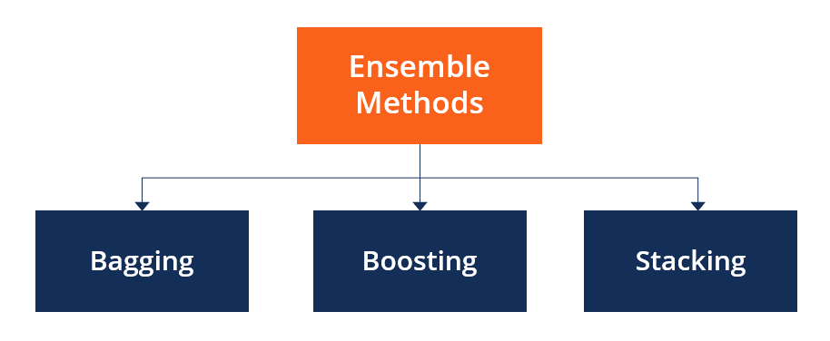
Ensemble Method :
Based on ensemble technique, the random forest algorithm executes.
An ensemble method is a machine learning technique where multiple models are combined to produce a single prediction. The idea behind ensemble methods is that combining multiple models can result in a more accurate prediction than relying on a single model.

Slide 6
There are several types of ensemble methods, including:
Bagging: Bagging (or Bootstrapped Aggregation) is a technique where multiple models are trained on different bootstrapped samples of the data, and the predictions of these models are combined.
Boosting: Boosting is a technique where multiple models are trained sequentially, with each model attempting to correct the mistakes made by the previous model.
Stacking: Stacking is a technique where multiple models are trained, and the predictions of these models are used as input to a final model, which makes the final prediction.

Slide 7
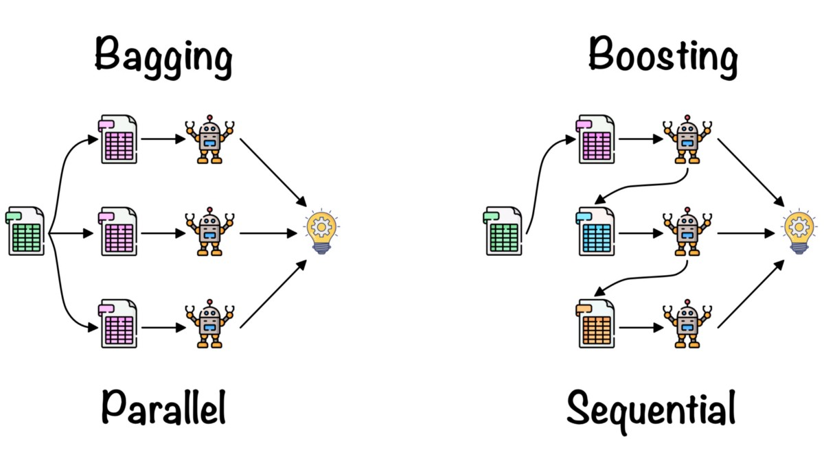
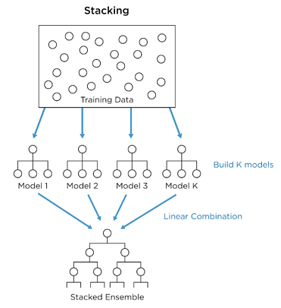

Slide 8
Here's how bagging works in Random Forest:
The training dataset is sampled with replacement to create several smaller datasets, known as bootstrap samples. Each bootstrap sample is of the same size as the original training dataset.
A decision tree is then trained on each bootstrap sample. These decision trees are called base models or weak learners.
The predictions of all the base models are combined to form the final prediction of the Random Forest. The final prediction is made by taking the average or majority vote of all the base models, depending on whether the problem is regression or classification.

Slide 9
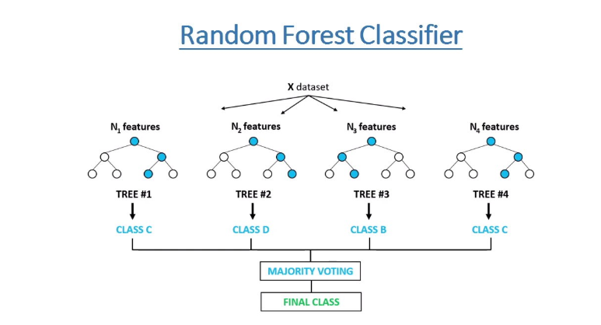

Slide 10
Ensemble methods are used in Random Forest because they can improve the accuracy and robustness of the predictions. In Random Forest, multiple decision trees are trained on different bootstrapped samples of the data, and the predictions of these trees are combined to produce a single prediction.
This approach has several advantages over relying on a single decision tree:
Reduced Overfitting: By combining multiple decision trees, Random Forest reduces the risk of overfitting, as the errors made by individual trees are averaged out.
Improved Accuracy: The combination of multiple decision trees can lead to improved accuracy, as each tree may capture a different aspect of the data.
Increased Robustness: Random Forest is less sensitive to the choice of hyper parameters and the presence of noisy or outlier data, as the predictions are based on the consensus of multiple trees.
Increased Diversity: By training decision trees on different bootstrapped samples of the data, Random Forest encourages diversity among the trees, which can lead to improved accuracy and robustness.

Slide 11
Training and Prediction :
Random Forest trains multiple decision trees and aggregates their predictions to make a final prediction as follows:
Sampling: The training dataset is sampled with replacement to create several smaller datasets, known as bootstrap samples.
Tree training: A decision tree is then trained on each bootstrap sample. These decision trees are called base models or weak learners.
Feature selection: At each split, only a random subset of the features is considered to determine the best split. This helps reduce the correlation between the base models and make the final prediction more robust.
Prediction aggregation: The predictions of all the base models are combined to form the final prediction of the Random Forest. The final prediction is made by taking the majority vote of all the base models

Slide 12
HYPER PARAMETER
The following are the common hyper parameters in Random Forest:
n_estimators: Number of trees in the forest.
criterion: The function to measure the quality of a split.
max_depth: Maximum depth of the tree.
min_samples_split: Minimum number of samples required to split an internal node.
min_samples_leaf: Minimum number of samples required to be at a leaf node.
max_features: Maximum number of features to consider when looking for the best split.
bootstrap: Whether bootstrap samples are used when building trees.
These hyper parameters can be tuned to optimize the performance of the Random Forest model for a specific problem.

Slide 13
Advantages of Random Forest:
Improved performance: Random Forest can provide improved performance compared to a single decision tree due to its use of multiple decision trees and its ability to reduce variance in the model.
Easy to use: Random Forest is easy to use and does not require extensive data preparation or feature scaling.
Handling missing values: Random Forest can handle missing values in the data, as it can build decision trees from partial datasets.
Interpreting results: Random Forest provides feature importance scores, which can be used to understand the most important features in the data.
Handle large datasets: Random Forest is capable of handling large datasets, making it a suitable algorithm for big data problems.

Slide 14
Disadvantages of Random Forest:
Computationally expensive: Random Forest is computationally expensive due to the need to train multiple decision trees.
Slower prediction: The prediction time of Random Forest is slower compared to other algorithms such as linear regression, as it needs to make predictions from multiple decision trees.

Slide 15
APPLICATIONS :
Random Forest is a versatile and widely used machine learning algorithm with several real-world applications, including:
Banking: Random Forest can be used to predict loan default, identify fraudulent transactions, and predict customer behavior.
Healthcare: Random Forest can be used to diagnose diseases, predict patient outcomes, and analyze medical imaging data.
E-commerce: Random Forest can be used to recommend products to customers, predict customer churn, and analyze customer behavior.

Slide 16
Environmental Science: Random Forest can be used to predict the impact of environmental factors on wildlife populations, predict the spread of invasive species, and analyze remote sensing data.
Agriculture: Random Forest can be used to predict crop yields, detect crop diseases, and analyze soil and weather data.
Stock Market Analysis: Random Forest can be used to predict stock prices, analyze financial data, and detect insider trading.

Slide 17
CONCLUSION :
In conclusion, Random Forest is a powerful and widely used machine learning algorithm that can be applied to a variety of problems. Some key points to summarize are:
Random Forest is an ensemble learning method that trains multiple decision trees and aggregates their predictions to make a final prediction.
The algorithm can handle large datasets, missing values, and provide feature importance scores, making it a valuable tool for data scientists.
Random Forest can provide improved performance compared to a single decision tree and can be used in a variety of domains such as banking, healthcare, e-commerce, environmental science, agriculture, and stock market analysis.
The algorithm has some limitations such as the potential for overfitting and computational expense, which should be considered when choosing the right algorithm for a problem.

Slide 18
THANK YOU

